Slide 1

Digital Logic vALIDATION
James E. Stine, Jr.
Edward Joullian Endowed Chair in Engineering
Oklahoma State University
Electrical and Computer Engineering Department
Stillwater, OK 74078 USA
james.stine@okstate.edu

Slide 2
Validation?
What is validation?
Validation is proving that my digital logic works.
In effect, its going backwards from synthesis.
Synthesis is going forward (i.e., idea to implementation)
How do I do this?
Should I apply all the possible combinations to the inputs to see if that works?
Why does this not always work?
If I cannot use all possible combinations, what inputs should I use?
Any suggestions?

Slide 3
Company vs. Validation
Companies spend an enormous amount of time in validation.
As I stated previously, some companies may spend 70%+ of their development time on validation!
Some companies are developing new strategies to test designs that may invoke new language structures.
One such language is called UVM or University Verification Methodology.
https://www.accellera.org/downloads/standards/uvm
This usually evolves into design complexity that may affect the time to market.
Why should I be concerned with time to market?
Designs are also becoming more complex making verification difficult.
Solution: use your brain and validate more intelligently!
You want to work smarter and not longer to validate designs.

Slide 4
Compiling Verilog
When you use vlog within MGC ModelSim it only pre-checks the syntax.
There may be other errors and will not be apparent until you simulate the design.
Always use a testbench to simulate your design.
A DO or Tcl file will help run the simulation through MGC ModelSim.
vsim –do file.do
vsim –do file.do –c (runs without GUI)
Response
HDL or Device
Under Test
(DUT)
Testbench
Vectors

Slide 5
HLS
Newer synthesis tools support something called high-level synthesis or HLS.
What is HLS?
HLS utilizes operators and easy constructs to support synthesis to logic.
Much of these ideas come from early work on compilers in the 80s and onward.
Vivado is our synthesizer, and it supports HLS!
For example
assign sum = a+b;
Older synthesis tools need to map the logic out gate by gate.
When using HLS, I still try to make the SV as close to what the logic it represents but also neat and easy to understand.
This helps the synthesis or “hardware compiler” get to the final netlist that is used for implementation.

Slide 6
MGC ModelSim vsim window

Slide 7
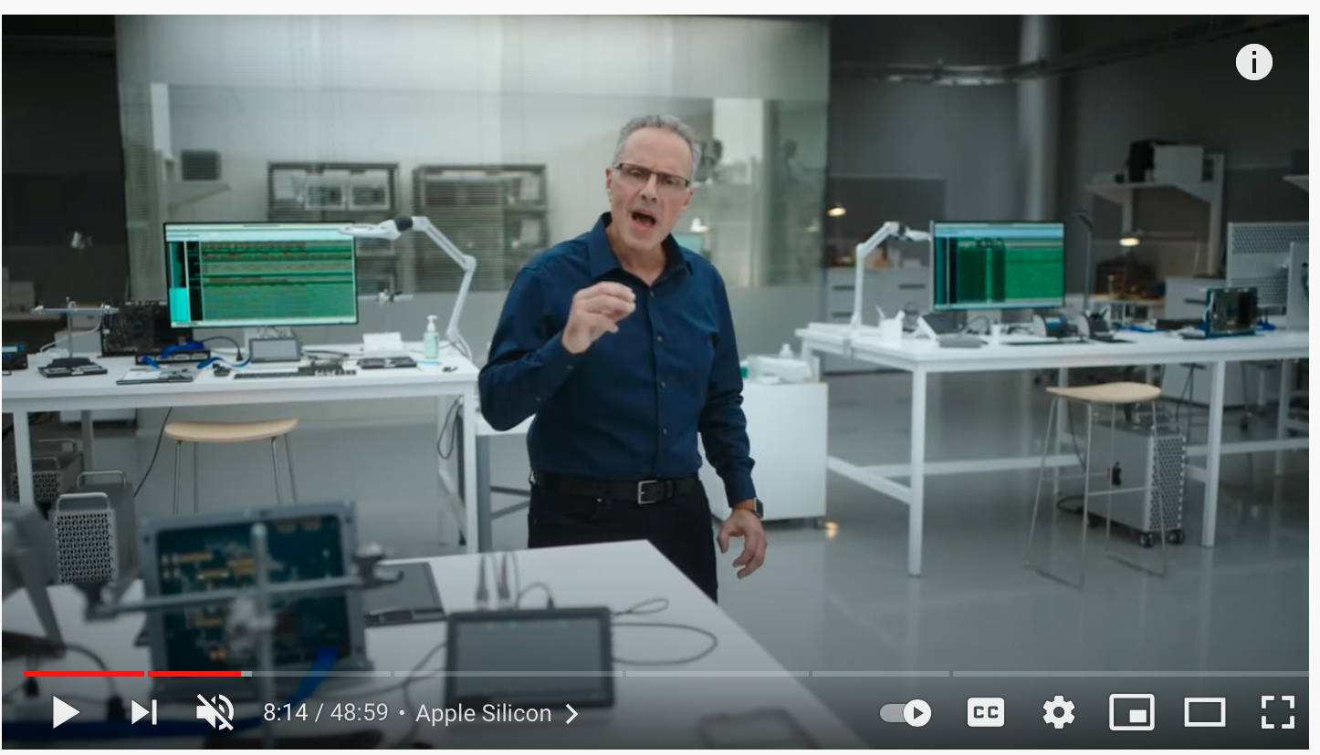
Coolness!
https://youtu.be/5AwdkGKmZ0I

Slide 8
Testbenches
HDL that tests another module: device under test (dut)
Not synthesizeable!!
Types (3 types from textbook in Chapter 4):
Simple
Self-checking (more later!)
Self-checking with testvectors
Testbenches are good with vectors that are known to be true!
These true vectors are typically called golden vectors or golden files.
Golden vectors can be either generated externally and read in or generated inside the testbench.
Either way, its always advantages to have a good collection of golden vectors that test real-world scenarios.

Slide 9
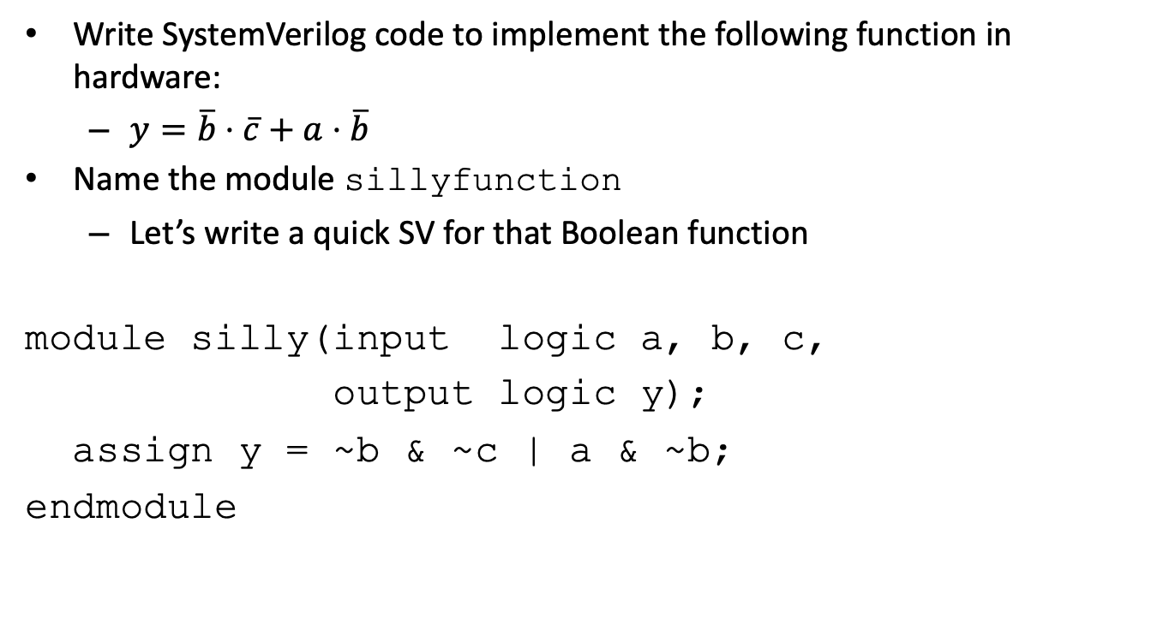
In-Class Example
Write SystemVerilog code to implement the following function in hardware:
$y=\overline{b}⋅\overline{c}+a⋅\overline{b}$
Name the module sillyfunction
Let’s write a quick SV for that Boolean function
module silly(input logic a, b, c,
output logic y);
assign y = ~b & ~c | a & ~b;
endmodule

Slide 10
Delays
module example(input logic a, b, c,
output logic y);
logic ab, bb, cb, n1, n2, n3;
assign #1 {ab, bb, cb} = ~{a, b, c};
assign #2 n1 = ab & bb & cb;
assign #2 n2 = a & bb & cb;
assign #2 n3 = a & bb & c;
assign #4 y = n1 | n2 | n3;
endmodule
Delays are not recommended as they can cause problems for logic, but they are highly useful for testbenches!!!!!
[Harris/Harris]

Slide 11
Simple Testbench
module testbench1();
logic a, b, c;
logic y;
// instantiate device under test
sillyfunction dut(a, b, c, y);
// apply inputs one at a time
initial begin
a = 0; b = 0; c = 0; #10;
c = 1; #10;
b = 1; c = 0; #10;
c = 1; #10;
a = 1; b = 0; c = 0; #10;
c = 1; #10;
b = 1; c = 0; #10;
c = 1; #10;
end
endmodule
Although this is a nice testbench, does it really test all the inputs well?
What should we do?

Slide 12
SV testbench
Although the best type of vectors to test are vectors that related to your design, there is sometimes a need to have a testbench that tests random vectors.
In the early 2000s, the IEEE 1364 standard committee adopted a random keyword that is helpful for randomization
You will find when you are doing simple logic, this helps create good testbench testing
$random
Here is an example:
#20 a = $random;
#0 b = $random;
#0 c = $random;

Slide 13
$random
$random was invented for Verilog to handle random inputs.
It will randomize the inputs based on the size of the declaration (e.g., input logic [3:0] A)
It is not very random as it utilizes Pseudo Random Number Generation (PRNG) which is usually based on a set seed value (i.e., an initial known value).
https://en.wikipedia.org/wiki/Pseudorandom_number_generator
This means if you use $random, you may notice it seems to start with the same random values every time you run it.
If you need more random inputs, you must create your own randomization functions.
$random is there to get things started.

Slide 14
Time?
What is time and how do we deal with in digital logic?
Time is the indefinite continued progress of existence and events that occur in an apparently irreversible succession from the past, through the present, into the future.
Event-driven simulation
With event-driven simulation we focus only on those times at which interesting events occur.
This is handled internally by a time-reference clock and then ticks of the simulated clock.
When nothing changes, it then updates the clock accordingly (e.g., a Boolean logic system).
Testbenches deal with time, so you must tell what the event-driven time is and its internal time-reference clock.
`timescale 1ns / 1ps
module tb ();
Placed at the top of your testbench to indicate specific time elements – make sure you annotate your DO file accordingly at the bottom for how much time you want to run!
run 250 ns

Slide 15
Intelligent Finish
If you integrate your own set number of iterations (we will see how to do this in coming slides), you can tell your testbench to finish when done.
This is done two ways:
run –all in your DO file (usually at the bottom)
The $finish inside the testbench tells SystemVerilog to stop what its testing and end.
Always test your testbench with small values until you know it finishes; then, expand it to run longer!
Can I tell my operating system to Email me or text me when things are done with the testing or even update me on things?
Yes!

Slide 16
What is a GUI?
A GUI is a graphical user interface and humans use it to visualize things.
GUIs are great but they are slow because they have to display to the monitor.
Verification is typically done in text as its faster and easier to perform independently; however, one must be careful with the output to see what is going on.
In ModelSim this can be done by invoking a DO file with the –c argument
Check out sample.zip
vsim –do sample.do –c

Slide 17

Initial statement
The initial statement is used in SystemVerilog mainly in testbenches to say, run this when you start.
initial statements are NEVER synthesized and should not be used in your main HDL for your digital logic.
initial statements can also employ for statements to help go through potential iterations.
Let’s look at a complex testbench.

Slide 18
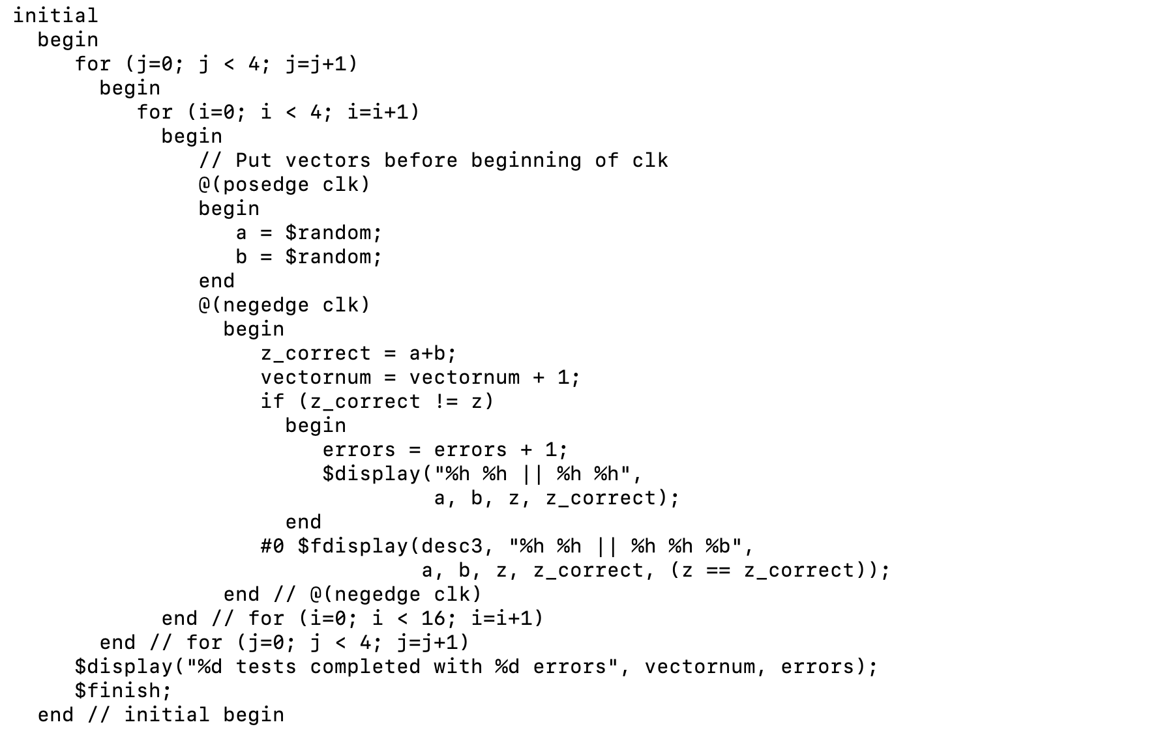
Intelligent Testing
What is this and what is it doing?
Correct Response
Is my Correct Response the same as the value obtained from my HDL?

Slide 19
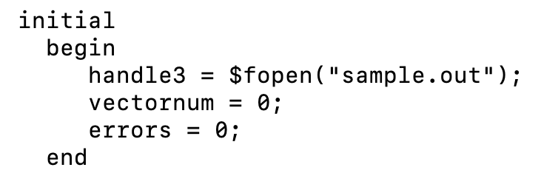
Output to a File
You can output things to a file, but you must set them up correctly.
This is done via the $fdisplay SystemVerilog command
$fdisplay requires a pointer to the file you are using
handle3 is the pointer declared as an integer (i.e., integer handle3;)
You can have many initial statements in your SV file, but its only run once (i.e., at the beginning of the simulation)
Use vector notation (e.g., %h) in SV to output using $fdisplay
#0 $fdisplay(handle3, "%h %h || %h %h %b", a, b, z, z_correct, (z == z_correct));

Slide 20
Output to the screen
You can also output to the screen with the $display command in SystemVerilog.
Anything inside $display() will display to the screen.
It can display text but also values from your simulation.
$display(“Hi, how are you?”)
$display(“My values are %h”, a)
What does %h mean? Have we seen this before?
Where does this text go?

Slide 21
Transcript window
ModelSim displays stuff to the screen, but it also copies that same value to the transcript file.
The transcript window is also inside the ModelSim vsim window.
If you want to see what was printed to the screen, just look at the transcript window (i.e., it should be a file called transcript).
cat transcript
type transcript
You can also open the file inside your text editor for inserting into lab reports.
You can also use the transcript window inside ModelSim to re-run your simulation without exiting.
do sample.do

Slide 22
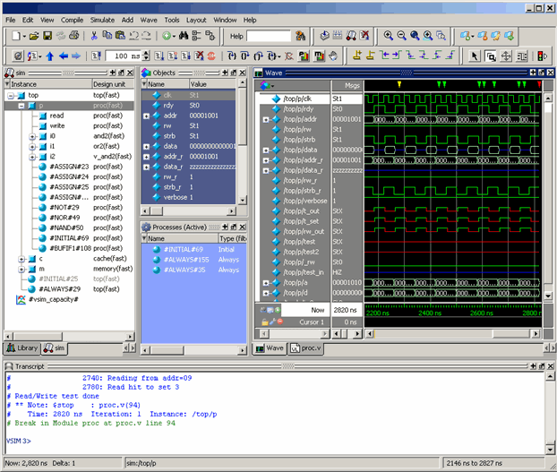
Key Parts to GUI (vsim)
Blue Dot
Sim
(displays hierarchy)
Objects
(shows values at wave marker)
Wave
transcript
[Siemens/MGC]

Slide 23
Oddities
For some reason, some windows do not always show up for me on ModelSim vsim window.
If you do not see the window, just go to the View menu to pull down what you need.
It is always good to have some patience with this process as I get frustrated sometimes that windows do not always appear.
I have used very early versions of ModelSim and they getting better, but they are not perfect.
EDA tools are only as good as the user who uses them!

Slide 24
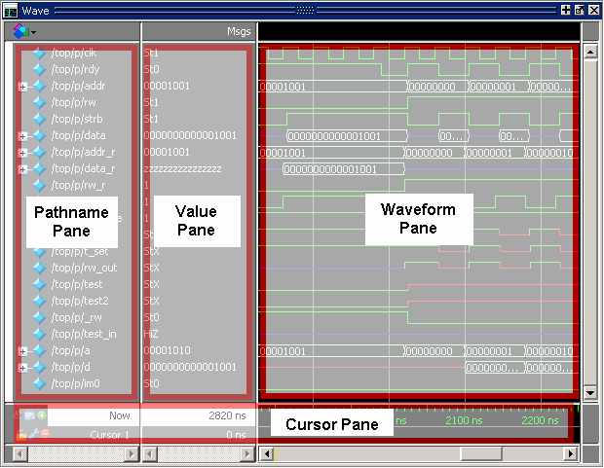
Wave Window
The wave window lists everything that you want to see.
You can see everything by typing the following in your DO file
add wave -hex -r /stimulus/*
Or you can segment to see things more individually (highly recommended)
#add wave -noupdate -divider -height 32 "ALU"
#add wave -hex /testbench/dut/arm/dp/alu/*
In the pathname plane, the full hierarchy is shown.
The value plane shows the value in the waveform plane at a given instance.
[Siemens/MGC]

Slide 25
The add wave command
This command should be default in your DO files within the repo
add wave -hex -r /stimulus/*
Unfortunately, this causes all signals to appear on your wave window.
If you have any hierarchy, this will cause signals to repeat.
You can avoid this by hand-crafting which signals to appear – this is tedious but sometimes helpful for debugging.
Remember, anything you put in the DO file can be replicated easily by anyone who has the DO file, testbench and your associated SV files.
From my personal viewpoint, hand-crafting DO files pays HUGE dividends later.

Slide 26
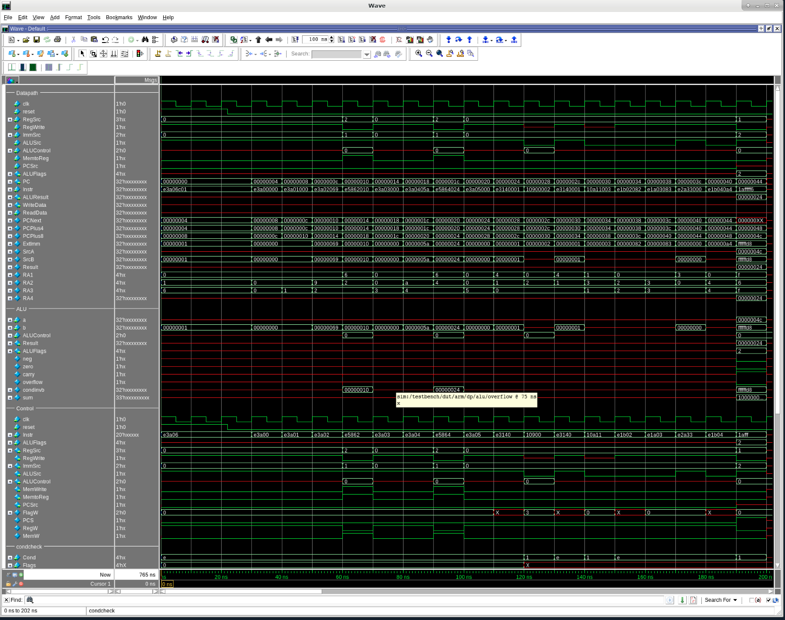
Use dividers
On the previous slide, I used dividers.
They are extremely helpful in segmenting what you want to see on the Wave window.

Slide 27
Inside Example DO File
-- display input and output signals as hexidecimal values
# Diplays All Signals recursively
# add wave -hex -r /stimulus/*
add wave -noupdate -divider -height 32 "Datapath"
add wave -hex /testbench/dut/arm/dp/*
add wave -noupdate -divider -height 32 "ALU"
add wave -hex /testbench/dut/arm/dp/alu/*
add wave -noupdate -divider -height 32 "Control"
add wave -hex /testbench/dut/arm/c/*
add wave -noupdate -divider -height 32 "condcheck"
add wave -hex /testbench/dut/arm/c/cl/cc/*
add wave -noupdate -divider -height 32 "Data Memory"
add wave -hex /testbench/dut/dmem/*
add wave -noupdate -divider -height 32 "Instruction Memory"
add wave -hex /testbench/dut/imem/*
add wave -noupdate -divider -height 32 "Register File"
add wave -hex /testbench/dut/arm/dp/rf/*
add wave -hex /testbench/dut/arm/dp/rf/rf
Notice it uses full hierarchy!

Slide 28

Windows are detachable
Windows in the vsim GUI are detachable.
You can click the center button to undock or dock a window.
This is useful to make it bigger and unobstructed.
vsim typically remembers what you did last time, so if it was undocked, I think it stays that way.

Slide 29
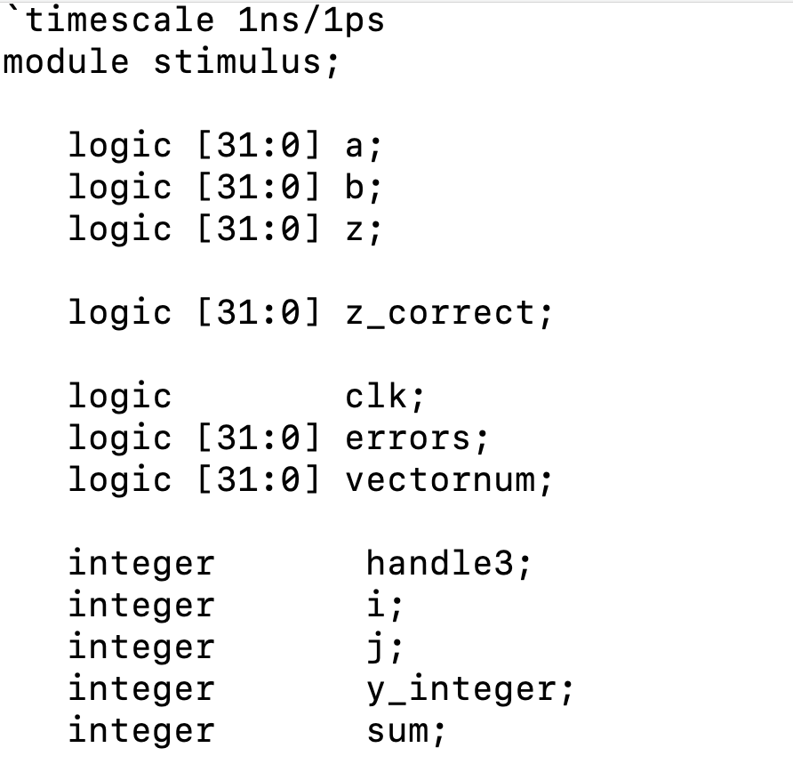
DO file compilation/simulation
# compile source files
vlog sample.sv tb_sample.sv
# start and run simulation
vsim -voptargs=+acc work.stimulus
The first line is important as it keeps the files compiled before they simulate them.
If you forget to vlog them, it might have an old change.
The vsim command runs the simulation with the name of the testbench module (e.g., stimulus)
Notice that testbenches do not have inputs or outputs (just logic declarations) !!!!
work.XXX is just used as that where it stores its event driven simulation (i.e., it is a directory).
work is the default but can be changed with the vlib command.

Slide 30

Instantiate Device Under Test (DUT)
The testbench is the top-most device in the SystemVerilog file.
Therefore, you should instantiate the part you want to test inside the testbench.
Make sure you use the local testbench variables to instantiate the device.

Slide 31
Clocks????
What is a clock?
A clock (which we will learn later) is used to synchronize signals.
It is basically a digital signal that goes up to Logic 1, down to Logic 0, and repeats.
Testbenches can use clocks to synchronize when devices are tested even if they do not use a clock.
Use your own methodology but a common one that is utilized as:
assign inputs (on rising edge)
compare outputs with expected outputs (on falling edge).
[Harris/Harris]

Slide 32
Reading files?
// at start of test, load vectors and pulse reset
initial
begin
$readmemb("example.tv", testvectors);
vectornum = 0; errors = 0;
reset = 1; #27; reset = 0;
end
// apply test vectors on rising edge of clk
always @(posedge clk)
begin
#1; {a, b, c, yexpected} = testvectors[vectornum];
end
// Note: $readmemh reads testvector files written in hexadecimal
File: example.tv
000_1
001_0
010_0
011_0
100_1
101_1
110_0
111_0
Yes, you can also read files as shown in the textbook (readmemb is binary readmemh is hexadecimal) → see HDL Example 4.39 in Chapter 4

Slide 33
wlf files
Simulation files get logged into wlf files
These files can be large for big simulations.
If you do not run a wave window, you will not have a wlf and reduce file size (BEWARE that these files get very large!)
They can also be loaded later but may not be easy to debug without windows and breakpoints.
See some of the references more on this item.
You can pull up a wlf file by typing vsim file.wlf

Slide 34
Recommendations
I would suggest two things.
First, use silly example for Lab 0 to understand simple verification.
Second, the sample.zip is for better verification.
You can examine sample.zip that I put on Canvas to help with some of the more advanced testbenches.
You will need these ideas for Lab 1.
Lab 1 is meant to help you understand debugging with testbenches better.
Lab 0 is just meant to showcase the process with a simple testbench.
Learn how to verify digital systems, since all systems use these principles (for both analog and digital systems).
Good verifications pays huge dividends for companies that utilize digital systems.
Again, some companies have told me they spend over 70% of their time on verification.
Learn now to really understand the process.

Slide 35
Summary
Verilog is a great HDL that allows you to design and simulate Boolean logic.
It MUST be handled with a great amount of responsibility in that you should always make sure your HDL is coded structurally.
Do not try to use software constructs that meant for testbenches without possible issues.
For example, If-then-else should be used in approved circumstances only.
Most importantly, never, ever, Google code to use - it leads to problems and just makes things difficult for anyone involved (trust me!)
Use a DO file to simulate your design so that others can easily simulate your design, as well.
All you have to do is share your DO file, Verilog files, and testbench.

